Slide 1


10Alytics Group 6 EDA PROJECT
Team Members
Princess Ige
Victor Etim
Kooffreh Essien
Abatan Olushola
Oluwatobi Adetimehin

Slide 2
PROBLEM STATEMENT
Uber has a constant imbalance in the demand and supply of rides which promotes poor customer retention. To achieve a balance and ensure there is a sufficient supply of rides to match the demand of customers, we will identify peak hours of the day in the most occurring start locations. This will help to know the locations to dispatch more riders to and what hours to do so. With this analysis we are looking to increase customer satisfaction and customer retention and once this is achieved, it’ll will ultimately boost profit and efficiency for Uber.
INSIGHTS
From exploring the dataset, we found out that:
The Location with the highest pickup point for trips is Cary.
The busiest time of the day for drivers are between the hours of 1pm and 4pm daily, while the busiest day of the week is Friday.
The analysis also shows that trips are being requested for majorly business engagements while we have a relatively few order of trips for personal activities. This can be said to be the reason why the number of trips during the weekend is smaller than that of the rest of the week.
The highest mileage that occurred was in the month of March, on a Friday by 4pm.

Slide 3
Dataset Overview
The dataset we would be using for this Exploratory Data Analysis is the Uber drives dataset gotten from Kaggle. This dataset comprises of a year long data of Uber trips in United State of America.
It has entries consisting of the start date and end date of the trip in a datetime format, Category of the trip, Start Location, End Location, Miles of each trip and the Purpose of each trip.
There are 7 columns and 1156 rows.

Slide 4
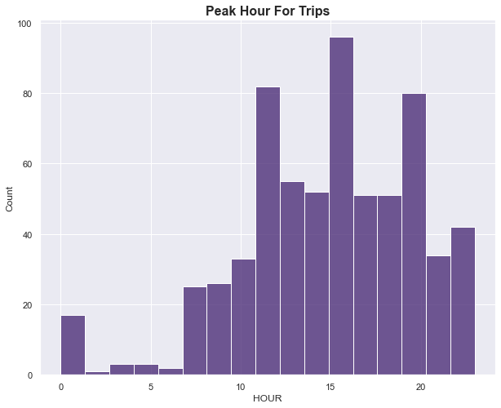
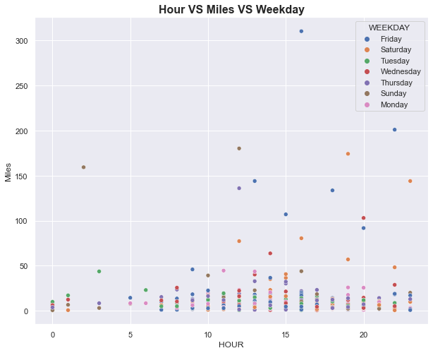
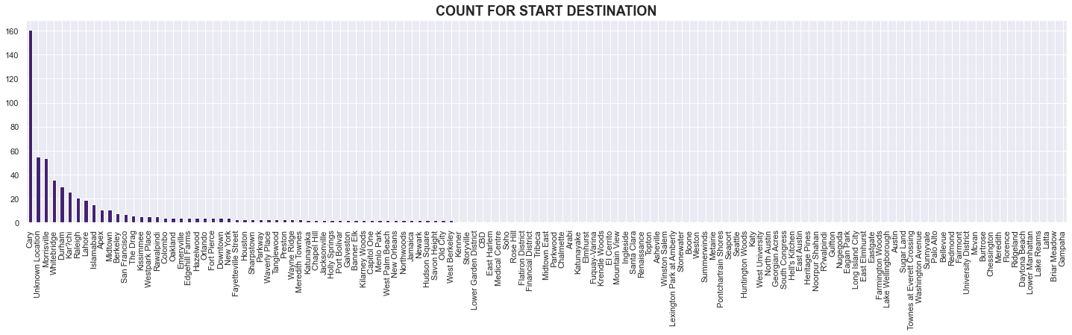
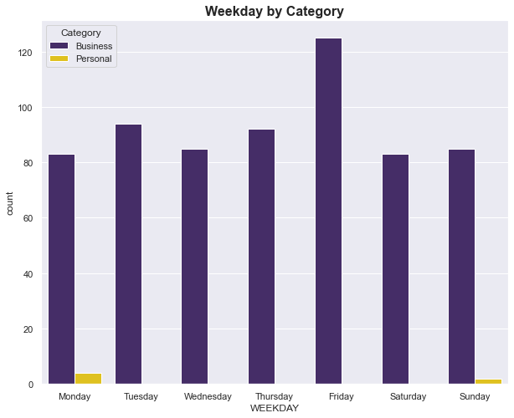
Visualizations

Slide 5
Conclusion and Recommendation
In conclusion, this analysis has pointed out important insights such as locations, and daytimes where there are high number of trips.
We recommend that, Uber needs to station or contract more drivers within Cary city to minimize waiting times, especially within the hours of 1pm - 4pm; hence, boosting customer satisfaction.
For locations with very little patronage like Gampaha, Latta, and Briar Meadows, Uber can attempt to run marketing campaigns like Ads on mobile apps or Youtube within those catchments.

